Slide 1
CS-2001 Data Structures
Week 1 | Lecture 1-3

Slide 2
Topics
ADT, C++ Language Specification,
Pointers revisited, Rule of Three,
Dynamic Safe Arrays

Slide 3
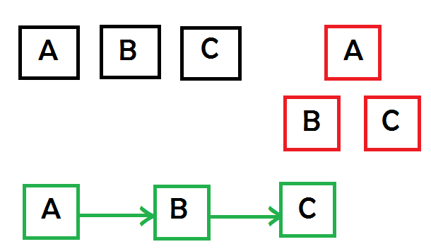
Data Structures
Data structure is a particular way of storing and arranging data (in a computer) so that it can be used efficiently

Slide 4
Data Type
Set of data with predefined values
OR
Something that can store particular “type” of values

Slide 5
Data Type
At the top level, there are two types of data types:
Primitive Data Types (System-defined Data Types)
User-defined Data Types

Slide 6
Primitive Data Types
Data types defined by the system
Examples: int, float, char, double, etc.

Slide 7
User-defined Data Types
Most programming languages allow users to define their own data types
Examples: structures in C, classes in C++ & JAVA

Slide 8
Abstract Data Type (ADT)
All primitive data types (int, float etc.) support basic operations like addition, subtraction
But what about user-defined data types???

Slide 9
Abstract Data Type (ADT)
For user-defined data types, we define operations and provide implementations for these operations whenever we want to use these data types

Slide 10
Abstract Data Type (ADT)
We combine data types with their operations and call it Abstract Data Types
An ADT consists of:
Declaration of data
Declaration of operations

Slide 11
Example
A class represent a new type, with user-defined operations represented by member functions
Create a list that contains different types of elements such that only last added element can be read (LIFO)

Slide 12
Abstract Data Type (ADT)
Commonly used ADTs include: Linked Lists, Stacks, Queues, Trees, Graphs, and many others
While defining an ADT, we do not worry about the implementation details until we need to use it

Slide 13
Dynamic Memory Allocation (DMA)
With the help of Dynamic Allocation, a program can obtain memory during runtime.
C++ defines two unary operators new and delete that perform the task of allocating and deallocating memory during runtime. Since these operators operate upon free store memory (Heap memory), they are also called free store operator.

Slide 14
Rule of Three C++
This rule basically states that if a class defines one (or more) of the following, it should explicitly define all three,
Destructor
copy constructor
copy assignment operator

Slide 15
SAFEARRAY and Jagged Array
SAFE ARRAY in data structure describes a particular instance of a safe array, specifying attributes such as its number of dimensions and a pointer to the actual safe array’s data.
Jagged array is array of arrays such that member arrays can be of different sizes, i.e., we can create a 2-D array but with a variable number of columns in each row. These type of arrays are also known as Jagged arrays.

